Slide 1
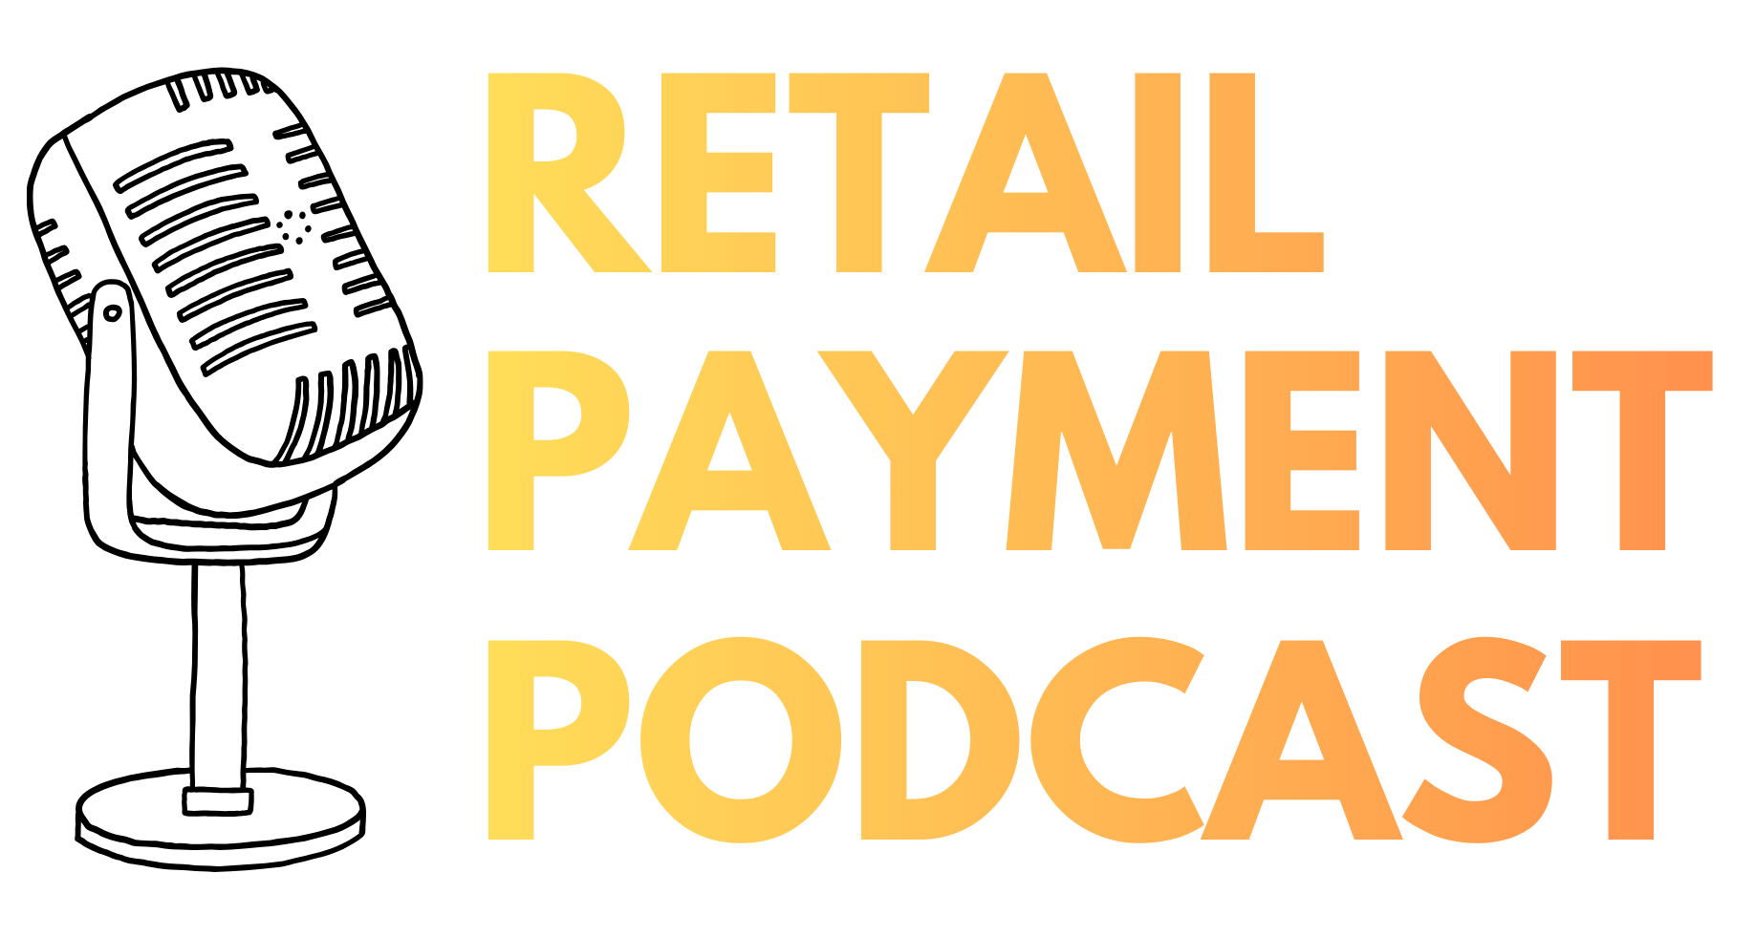
Retailpayment.io
1

Slide 2
AGENTIC COMMERCE · Clear Insights, Simply Explained, Easy to Grasp
The Complete 6-Layer Protocol Stack
Layer 1 · User & Application
Full Architecture: MCP, UCP, AP2,
Mastercard Agent Pay & Visa Intelligent Commerce Connect
Layer 2 · MCP Transport
The Full Transaction Flow
Layer 3 · Commerce Protocol
How Everything Works Together
The Protocol Stack, Explained Simply in 3 Slides
Agentic Commerce: Simple because of Modular
Retailpayment.io
1

Slide 3
AGENTIC COMMERCE · FULL ARCHITECTURE
The Complete
6-Layer Protocol Stack
Layer 1 · User & Application
Layer 2 · MCP Transport
Full Architecture:
MCP, UCP, AP2,
Mastercard Agent Pay &
Visa Intelligent Commerce Connect
Layer 3 · Commerce Protocol
Layer 4 · Payment Authorization
Layer 5 · Payment Processing
Layer 6 · Settlement & Fulfillment
Retailpayment.io
1

Slide 4

LAYER 1: USER & APPLICATION LAYER
Consumer, Agent, Platform
End users and AI agents (ChatGPT, Claude, Gemini) requesting to buy products. This is where intent is expressed.
Consumer
AI Agent (ChatGPT, Claude)
Shopping Platform
Voice Assistant
Retailpayment.io
2

Slide 5

LAYER 2: CONNECTIVITY & TRANSPORT PROTOCOL
Model Context Protocol (MCP)
The universal connectivity layer. Provides a standardized way for AI agents to discover and access tools/services. The “highway” connecting agents to merchant systems.
MCP Servers
JSON-RPC 2.0
Tool Discovery
Data Access
Capability Negotiation
Retailpayment.io
3

Slide 6

LAYER 3: COMMERCE PROTOCOL LAYER
UCP (Google), ACP (OpenAI), + Specific Merchant APIs
Commerce-specific protocols that run WITHIN MCP servers. Define how agents discover products, manage carts, negotiate terms, and execute checkouts across merchant ecosystems.
UCP Discovery
Product Catalog
Cart Management
Checkout API
Order Management
Retailpayment.io
4

Slide 7

LAYER 4: PAYMENT AUTHORIZATION PROTOCOL
AP2 (Google), MPP (Stripe), x402 (Crypto)
Payment-specific authorization layer. Handles cryptographic proofs of user consent, agent verification, and transaction authorization between agents and payment networks.
AP2 Mandates
Cryptographic Proof
Agent Verification
Transaction Signing
Intent Verification
Retailpayment.io
5

Slide 8

LAYER 5: PAYMENT PROCESSING & TRUST LAYER
Mastercard Agent Pay vs Visa Intelligent Commerce Connect
Payment network solutions for executing transactions. Mastercard focuses on integrated trust & tokenization; Visa focuses on protocol-agnostic infrastructure.
Mastercard Agentic Tokens
Visa Intelligent Commerce APIs
Tokenization
Spend Controls
Network Settlement
Retailpayment.io
6

Slide 9

LAYER 6: SETTLEMENT, FULFILLMENT & COMPLIANCE
Network Settlement, Logistics, Dispute Resolution
Final transaction settlement across payment networks, merchant fulfillment, tracking updates, dispute resolution, and regulatory compliance.
Network Settlement
Fulfillment Handoff
Tracking & Updates
Compliance Reports
Dispute Management
Retailpayment.io
7

Slide 10
AGENTIC COMMERCE · FULL ARCHITECTURE
The Complete
6-Layer Protocol Stack
Layer 1 · User & Application
Layer 2 · MCP Transport
Full Architecture:
MCP, UCP, AP2,
Mastercard Agent Pay &
Visa Intelligent Commerce Connect
Layer 3 · Commerce Protocol
Layer 4 · Payment Authorization
Layer 5 · Payment Processing
Layer 6 · Settlement & Fulfillment
Retailpayment.io
1

Slide 11

Transaction Flow: How Everything Works Together
1
User Intent
2
MCP Discovery
Consumer asks AI agent: “Buy running shoes under € 150”
Agent connects to merchant MCP servers, discovers available services (catalog, checkout, payment)
Layer 1: User & Application
Layer 2: MCP Transport
3
Catalog Search
4
Negotiation
Agent searches product catalog via UCP Discovery protocol running on MCP server
Agent & merchant compute capability intersection: payment methods, shipping options, discounts
Layer 2: MCP + Layer 3: UCP
Layer 3: UCP Negotiation
5
Checkout Initiation
6
Payment Authorization
Agent calls UCP Checkout API (single call includes taxes, shipping, discounts, payment)
AP2 creates cryptographic CheckoutMandate + PaymentMandate with proof of user intent
Layer 2: MCP + Layer 3: UCP
Layer 4: AP2 Protocol
7
Payment Processing
8
Settlement & Fulfillment
Mastercard or Visa layer processes: generates token, verifies agent, executes payment via PSP
Order confirmed, network settles transaction, fulfillment initiated, tracking info returned via MCP
Layer 5: Agent Pay or Intelligent Commerce
Layer 6: Settlement + MCP Callback
Retailpayment.io
8

Slide 12

Mastercard Agent Pay vs Visa Intelligent Commerce Connect
Mastercard Agent Pay
Visa Intelligent Commerce
FOCUS: TRUST & AUDITABILITY
FOCUS: OPENNESS & SCALE
Mastercard’s answer integrates deeper than Visa.
Visa’s answer is PROTOCOL-AGNOSTIC infrastructure.
Agentic Tokens replace credit card numbers
Know Your Agent verification (KYA)
Built-in fraud detection & transaction traceability
Verifiable Intent aligns with AP2
Target: Regulated use cases, B2B, high-value transactions
Works with Visa AND non-Visa networks
Supports ACP, UCP, TAP, MPP all equally
Multiple token vault providers (no lock-in)
Catalog discoverability built-in
Target: All merchants, maximum reach & flexibility
Retailpayment.io
12

Slide 13
AGENTIC COMMERCE · Clear Insights, Simply Explained, Easy to Grasp
The Protocol Stack, Explained Simply in 3 Slides
Layer 1 · User & Application
Layer 2 · MCP Transport
6- Layer Protocol Stack
Transaction Flow: How Everything works together
Layer Integration & Real-World Deployment
Layer 3 · Commerce Protocol
Retailpayment.io
1

Slide 14
AGENTIC COMMERCE · FULL ARCHITECTURE
The Complete
6-Layer Protocol Stack
Layer 1 · User & Application
Layer 2 · MCP Transport
Full Architecture:
MCP, UCP, AP2,
Mastercard Agent Pay &
Visa Intelligent Commerce Connect
Layer 3 · Commerce Protocol
Layer 4 · Payment Authorization
Layer 5 · Payment Processing
Layer 6 · Settlement & Fulfillment
Retailpayment.io
1

Slide 15
Transaction Flow: How Everything Works Together
1
User Intent
2
MCP Discovery
Consumer asks AI agent: “Buy running shoes under € 150”
Agent connects to merchant MCP servers, discovers available services (catalog, checkout, payment)
Layer 1: User & Application
Layer 2: MCP Transport
3
Catalog Search
4
Negotiation
Agent searches product catalog via UCP Discovery protocol running on MCP server
Agent & merchant compute capability intersection: payment methods, shipping options, discounts
Layer 2: MCP + Layer 3: UCP
Layer 3: UCP Negotiation
5
Checkout Initiation
6
Payment Authorization
Agent calls UCP Checkout API (single call includes taxes, shipping, discounts, payment)
AP2 creates cryptographic CheckoutMandate + PaymentMandate with proof of user intent
Layer 2: MCP + Layer 3: UCP
Layer 4: AP2 Protocol
7
Payment Processing
8
Settlement & Fulfillment
Mastercard or Visa layer processes: generates token, verifies agent, executes payment via PSP
Order confirmed, network settles transaction, fulfillment initiated, tracking info returned via MCP
Layer 5: Agent Pay or Intelligent Commerce
Layer 6: Settlement + MCP Callback
Retailpayment.io
8

Slide 16


Real-World Deployment by Merchants
How to be Agentic Commerce Ready (2026)
How a major retailer implements this for being Agentic Commerce Ready:
Deploy MCP server
Exposing UCP catalog & checkout APIs
Implement AP2 mandate generation in checkout response
Integrate BOTH Mastercard Agent Pay AND Visa Intelligent Commerce
Support UCP for Google Search / Gemini AND ACP for ChatGPT
Merchants should choose payment path based on transaction risk
13

Slide 17
Retailpayment.io
1

