Slide 1
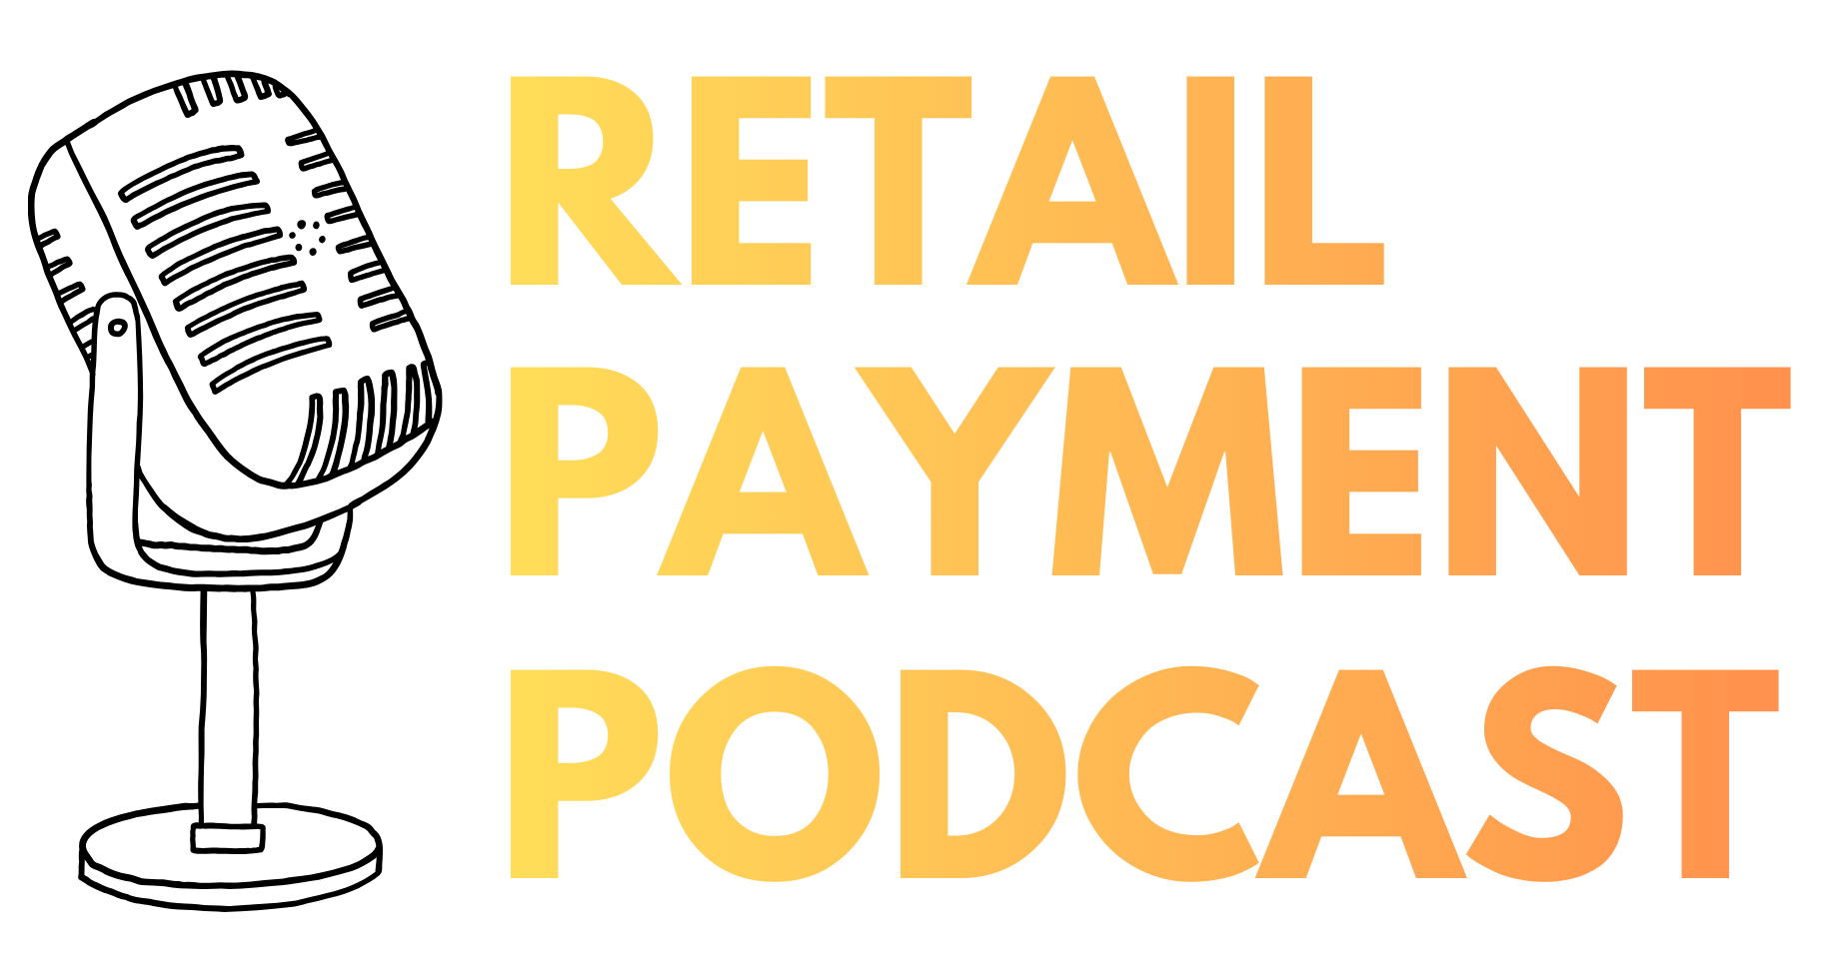
Retailpayment.io
1
Notes:
Welcome to a new episode of RetailPayment.io, the podcast about payment, e commerce and the technologies behind modern digital retail.
Today I am going to walk through the full architecture behind agentic commerce, the technology that lets an AI agent shop and pay on your behalf.

Slide 2
STRATEGY BRIEF · 2026
Main benefits for merchants
supporting MCP
Why adopting the Model Context Protocol is an asymmetric bet:
Large Conditional Upside & Real Structural Payoff Today.
Prepared for merchant leadership by Retailpayment.io

Slide 3
AT A GLANCE
Re-fresh: the three transports
01
02
03
REST
MCP
A2A
Software ↔ Software
AI ↔ Tool
AI ↔ AI
Traditional HTTP request/response. JSON over versioned URLs. The default path Google documents for Universal Cart.
JSON-RPC tool protocol from Anthropic. Agents discover and call tools dynamically. UCP capabilities map 1:1 to MCP tools.
Agent-to-agent task protocol. Multi-turn conversation between peer agents with a stateful Task lifecycle.
Stateless calls
Static discovery
Every backend dev knows it
Dynamic tools/list
AI-agent native
SSE streaming
Task + Artifacts
Stateful lifecycle
Long-running workflows
UCP TRANSPORT by Retailpayemnt.io
02 · AT A GLANCE

Slide 4


FRAMEWORK
Two categories of benefits
The case for supporting MCP rests on two very different kinds of value, and they should be evaluated separately.
Growth · Conditional
Structural · Always-on
3 benefits dependent on agentic adoption
4 benefits that pay back regardless of market
New distribution channel
Higher-intent traffic
Defensive positioning
Customer relationship retention
One integration, many AI clients
Dual-use internal infrastructure
Stronger governance
Prepared for merchant leadership by Retailpayment.io

Slide 5
PART ONE
Growth benefits
Conditional on agentic-commerce adoption
3 benefits · large upside if agent shopping scales
Prepared for merchant leadership by Retailpayment.io

Slide 6

01
GROWTH BENEFIT
New distribution channel without paid acquisition
The agentic-era analog of being indexed by Google in 1998.
As AI assistants become a primary starting point for shopping queries, MCP-supporting merchants are discoverable by agents while non-supporting ones are not. This is a free distribution surface that compounds as the channel grows, no CPC, no marketplace fees, no platform tax. The categories where this matters most today are technology, gifting, B2B and procurement, and any niche or long-tail catalog where customers know what they want but don't know who sells it.
Prepared for merchant leadership by Retailpayment.io

Slide 7
01
GROWTH BENEFIT
New distribution channel without paid acquisition
The agentic-era analog of being indexed by Google in 1998.
1
New discoverability.
AI assistants are becoming a primary starting point for shopping:
MCP-supporting merchants are discoverable by agents, others are not.
2
No platform tax.
A distribution surface that compounds as the channel grows:
no CPC, no marketplace fees, no platform tax.
3
Where it matters most.
Technology, gifting, B2B & procurement, and any niche or long-tail catalog.
Prepared for merchant leadership by Retailpayment.io

Slide 8

02
GROWTH BENEFIT
Higher-intent traffic, especially for specialty catalogs
Agents arrive with explicit purchase intent, not browse intent.
An agent-mediated buyer arrives knowing exactly what they need, "trail-running shoes under €150, delivered Friday“, rather than casually browsing. If your data is clean, conversion skews materially higher than ad-driven traffic.
Specialty and long-tail merchants benefit disproportionately: agents will read structured product specifications that human shoppers rarely scroll through, meaning products that lose at SEO can win at agent-search.
Prepared for merchant leadership by Retailpayment.io

Slide 9
02
GROWTH BENEFIT
Higher-intent traffic, especially for specialty catalogs
Agents arrive with explicit purchase intent, not browse intent.
1
Explicit intent.
Agent-mediated buyers arrive knowing exactly what they need, e.g. „trail-running shoes under €150, delivered Friday“.
2
Higher conversion.
With clean product data, conversion skews materially higher than ad-driven traffic.
3
Long-tail wins.
Agents read structured specs humans rarely scroll, so products that lose at SEO can win at agent-search.
Prepared for merchant leadership by Retailpayment.io

Slide 10

03
GROWTH BENEFIT
Defensive positioning against disintermediation
If you don't run your own surface, someone else will run it for you.
If agents become a dominant shopping surface, you will be discovered either way but without your own MCP server, super-aggregator agents will mediate you through third-party data on their terms.
Running your own surface is how you participate in agentic commerce without being intermediated by a layer you don't control.
The merchants who delay this decision cede pricing, presentation, and customer context to whoever builds the aggregator first.
Prepared for merchant leadership by Retailpayment.io

Slide 11
03
GROWTH BENEFIT
Defensive positioning against disintermediation
If you don't run your own surface, someone else will run it for you.
1
Discovered either way.
If agents become a dominant shopping surface, you will be present regardless.
2
But on whose terms?
Without your own MCP server, super-aggregators mediate you through third-party data.
3
Own your surface.
Participate in agentic commerce without an intermediary layer you don't control.
4
The cost of waiting.
Delay cedes pricing, presentation, and customer context to whoever builds the aggregator first.
Prepared for merchant leadership by Retailpayment.io

Slide 12
PART TWO
Structural benefits
Real today, regardless of how fast the agent market scales
4 benefits · payoff captured immediately
Prepared for merchant leadership by Retailpayment.io

Slide 13

04
STRUCTURAL BENEFIT
You keep the customer relationship
The structural difference between MCP and a marketplace.
On Amazon or eBay the marketplace absorbs the buyer's identity, data, and post-purchase contact.
With MCP you remain Merchant of Record, you define which tools the agent can call, and you keep the customer record.
Agents route buyers to you rather than replacing you in the transaction.
This single property is the core reason MCP is strategically different from "just joining another marketplace."
Prepared for merchant leadership by Retailpayment.io

Slide 14
04
STRUCTURAL BENEFIT
You keep the customer relationship
The structural difference between MCP and a marketplace.
1
Marketplaces take the customer.
Amazon or eBay absorb the buyer's identity, data, and post-purchase contact.
2
You stay Merchant of Record.
Define which tools the agent can call, and keep the customer record.
3
Routed, not replaced.
Agents send buyers to you rather than standing in for you in the transaction.
4
The core difference.
This is why MCP is strategically unlike „just joining another marketplace“.
Prepared for merchant leadership by Retailpayment.io

Slide 15

05
STRUCTURAL BENEFIT
One integration, many AI clients
MCP is the USB-C for AI — one server, all the clients.
Without a standard, you would build and maintain a separate connector for every AI platform: Claude, ChatGPT, Gemini, Copilot, plus the enterprise agents emerging from Salesforce, ServiceNow, and others.
MCP collapses that into one server.
Labor and maintenance savings grow as the agent ecosystem expands, and because MCP is now governed under the Linux Foundation rather than a single vendor, lock-in risk is materially lower than with any proprietary alternative.
Prepared for merchant leadership by Retailpayment.io

Slide 16
05
STRUCTURAL BENEFIT
One integration, many AI clients
MCP is the USB-C for AI: one server, all the clients.
1
One server, all clients.
No separate connector per platform, Claude, ChatGPT, Gemini, Copilot, plus enterprise agents.
2
USB-C for AI.
MCP collapses many integrations into a single standard interface.
3
Savings compound.
Labor and maintenance drop further as the agent ecosystem expands.
4
Low lock-in.
Governed under the Linux Foundation, not a single vendor.
Prepared for merchant leadership by Retailpayment.io

Slide 17

06
STRUCTURAL BENEFIT
Dual-use internal infrastructure
The same server powers your own AI tools, not just external agents.
The MCP server that exposes data to external agents is directly consumable by your internal AI tools: customer service bots, merchandising assistants, inventory monitoring, and analytics agents.
You are building a reusable tool layer for the business, not a single-purpose external integration.
This materially changes the ROI calculation: the spend is justified by internal productivity even before any external agent traffic arrives.
Prepared for merchant leadership by Retailpayment.io

Slide 18
06
STRUCTURAL BENEFIT
Dual-use internal infrastructure
The same server powers your own AI tools, not just external agents.
1
Dual-use by design.
The same server feeds internal AI tools: service bots, merchandising, inventory, analytics.
2
A reusable tool layer.
You build infrastructure for the business, not a single-purpose external integration.
3
ROI before traffic.
Spend is justified by internal productivity before any external agent arrives.
Prepared for merchant leadership by Retailpayment.io

Slide 19

07
STRUCTURAL BENEFIT
Stronger governance than ad-hoc API exposure
Safer than the alternative many merchants drift into.
A properly designed MCP server provides tool-level scoping (an external agent can search the catalog but not access customer history), rate-limiting by intent, audit logs of every agent interaction, and agent attestation.
That is structurally safer than the path many merchants drift into when integrating AI tools: handing models raw admin-API access with no clear audit trail and no way to constrain what each agent can do.
Prepared for merchant leadership by Retailpayment.io

Slide 20
07
STRUCTURAL BENEFIT
Stronger governance than ad-hoc API exposure
Safer than the alternative many merchants drift into.
1
Scoped access.
Tool-level permissions, rate-limiting by intent, full audit logs, and agent attestation.
2
Safer than ad-hoc.
Beats handing models raw admin-API access with no audit trail or constraints.
3
Avoid the drift.
The risky path many merchants fall into when wiring up AI tools.
Prepared for merchant leadership by Retailpayment.io

Slide 21

CONCLUSION
An asymmetric bet
The picture is asymmetric: large conditional upside, real structural payoff today.
IF THE MARKET SCALES
IF IT DOESN'T
Growth benefits unlock: distribution, conversion quality, and defensive positioning all compound.
Structural benefits still pay back: customer retention, integration efficiency, dual-use infrast., governance.
RECOMMENDATION
At a minimum, implement a basic MCP server. The downside of inaction is meaningful if the market grows; the structural payoff is captured immediately if it doesn't.
Prepared for merchant leadership by Retailpayment.io

Slide 22
Retailpayment.io
1
Notes:
Welcome to a new episode of RetailPayment.io, the podcast about payment, e commerce and the technologies behind modern digital retail.
Today I am going to walk through the full architecture behind agentic commerce, the technology that lets an AI agent shop and pay on your behalf.

